Slide 1
AIBridge
Lecture 7
Notes:
Welcome back! Just a few warnings before we start: today’s lecture will be a very

Slide 2
Introducing Unsupervised Learning
Credit: Andrew Ng, Machine Learning
Notes:
We’ve spent the past few lectures discussing “supervised” learning. As a recap, “supervised” learning is when you effectively tell your models what the outputs they should map to are. You have clearly defined “labels” and different combinations of feature values map to different labels. In effect, you give data to your model and it tries to find the “right answer”. But sometimes, you end up with problems that don’t neatly fit into square boxes. Or, you may not know exactly the shape your data will take on until you process it. Today, we will be talking about unsupervised learning.
Unsupervised learning on the other hand deals with unlabeled data. Effectively, the system tries to find patterns in the dataset, and your data gets grouped up based on these patterns.

Slide 3
Unsupervised Learning
Clustering
Dimension reduction
Notes:
So as you can imagine, unsupervised learning is a very broad term. Let’s narrow the discussion a bit by focusing on only two types of unsupervised learning: clustering and dimension reduction.

Slide 4
Credit: Andrew Ng, Machine Learning
Notes:
Let’s talk about clustering with a cute example. Look! A panda gave birth to twins! I love pandas they’re my favorite animal. But what do all these news articles tell us besides the fact that people are very interested in pandas?
Take a look at how your search results end up being grouped by similar threads. When you google something, you’re returned articles that are considered “similar” to each other and to your query. Basically, your search results form a cluster of like minded pages.
This is the idea behind “clustering”. You have a certain amount of data points which are then grouped together based on their similarity to each other. So, you need a way to measure this similarity called a “similarity metric”.
News is an example where it will be very difficult to do supervised learning – in the sense if someone searches for “panda”, you label panda news and put them together.

Slide 5
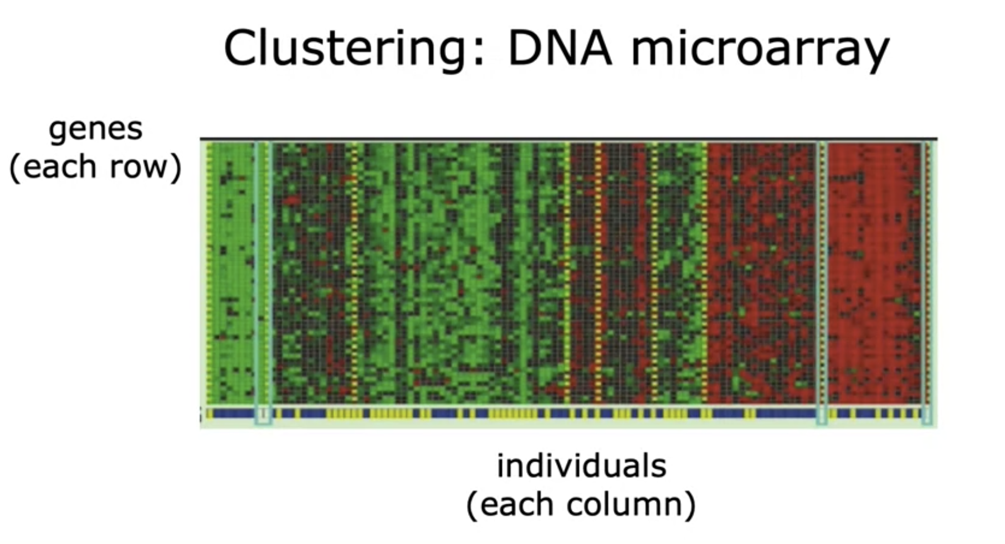
Credit: Andrew Ng, Machine Learning
Notes:
Let’s take another example.

Slide 6
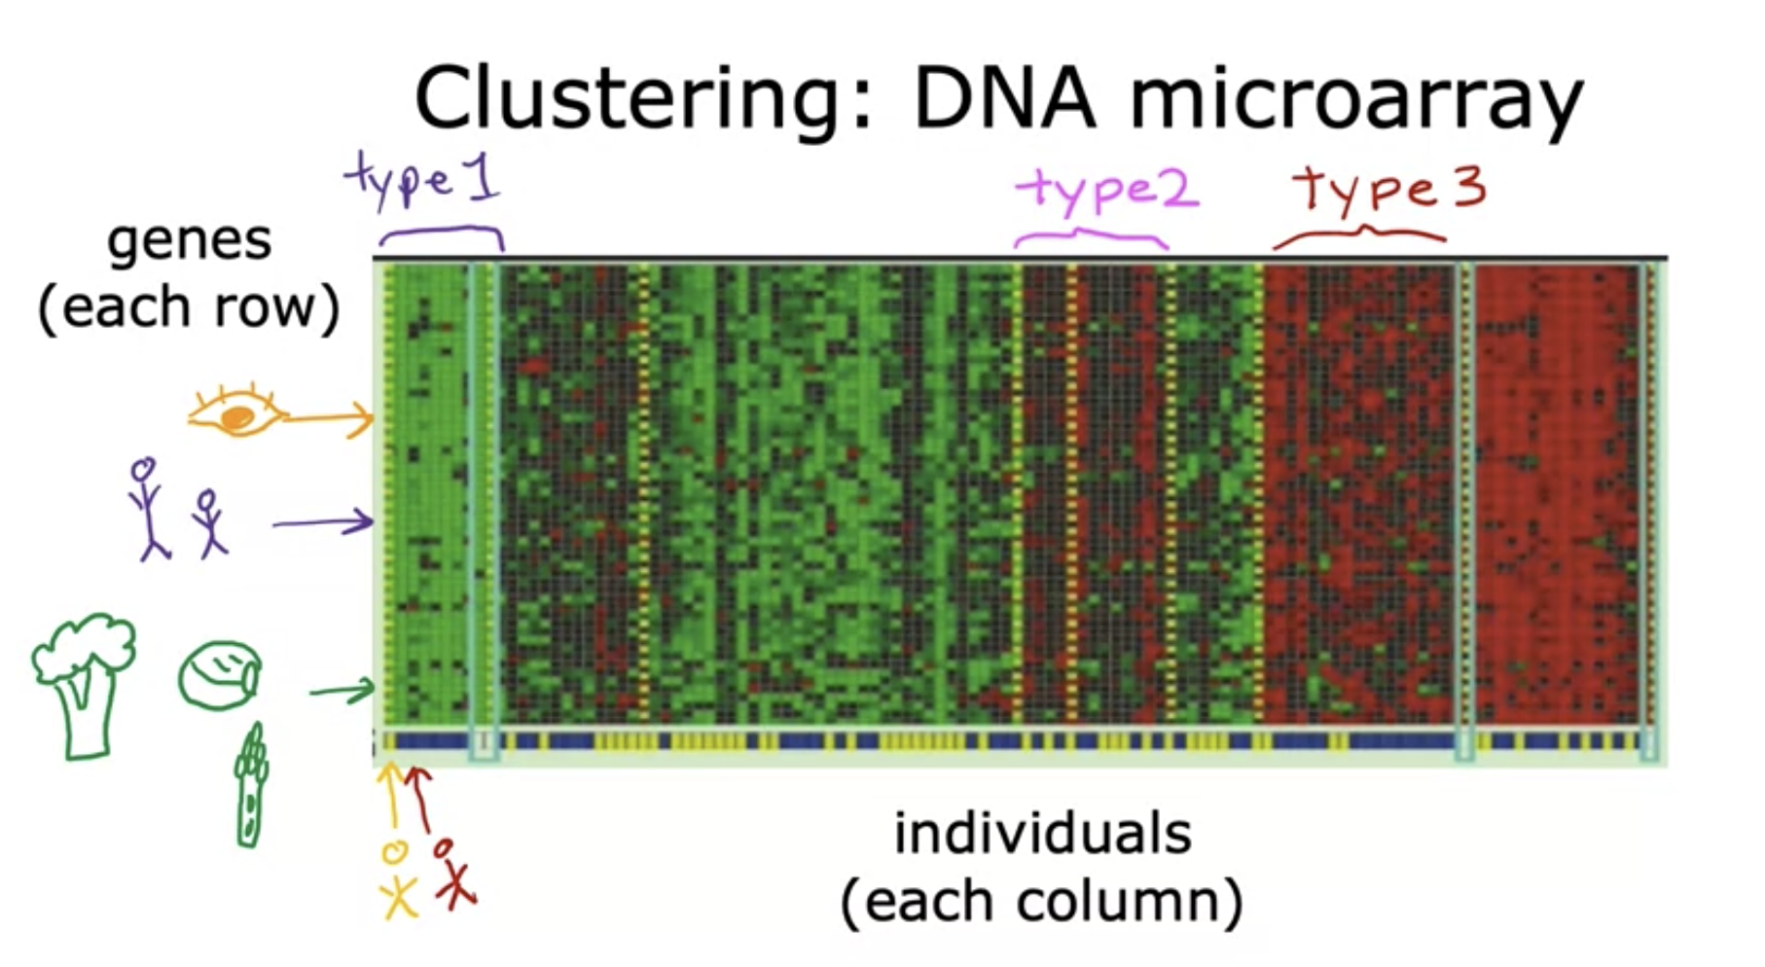
Credit: Andrew Ng, Machine Learning
Notes:
Genes get grouped together based on their expression similarity

Slide 7
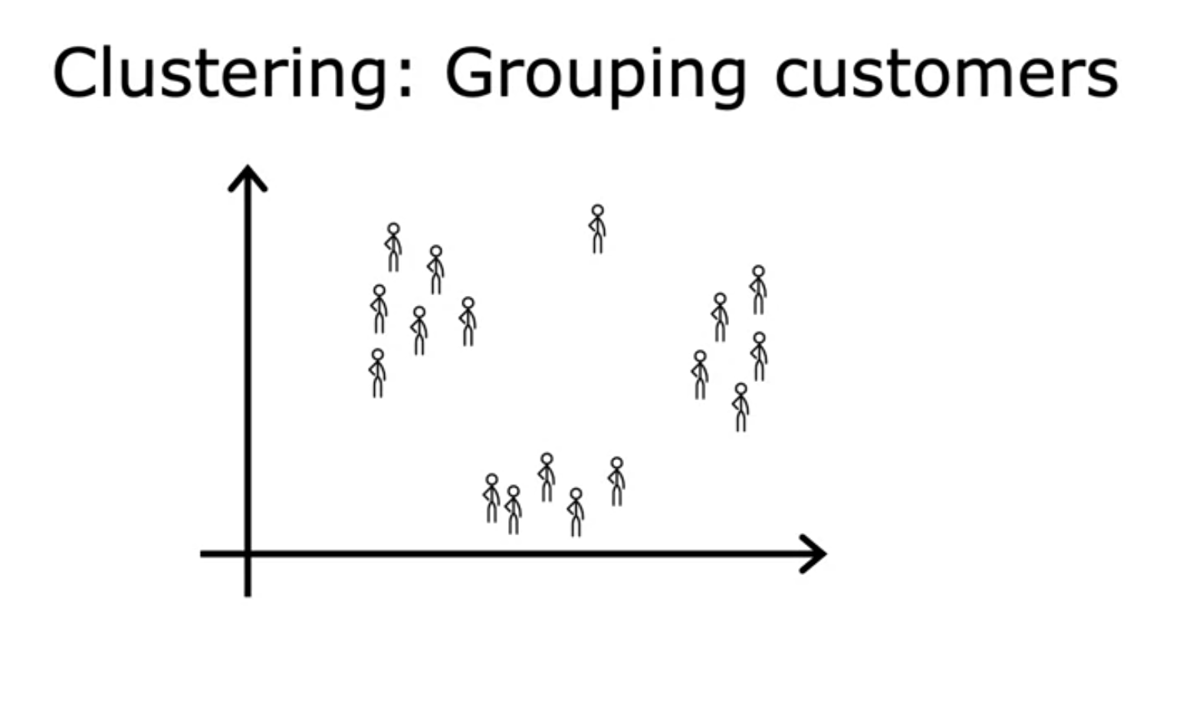
Credit: Andrew Ng, Machine Learning

Slide 8
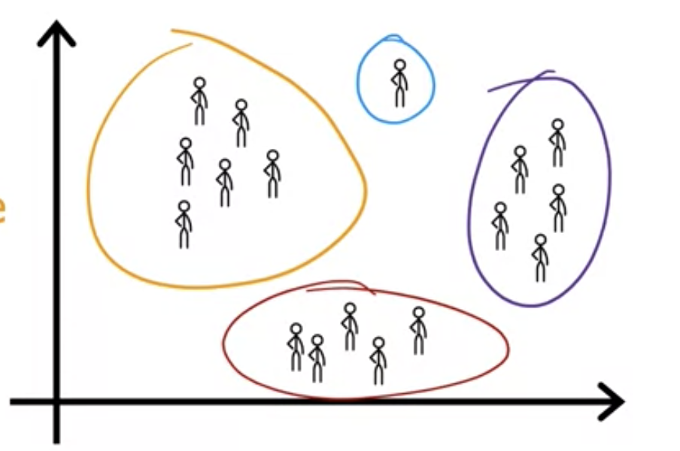
Grouping Customers
Credit: Andrew Ng, Machine Learning

Slide 9
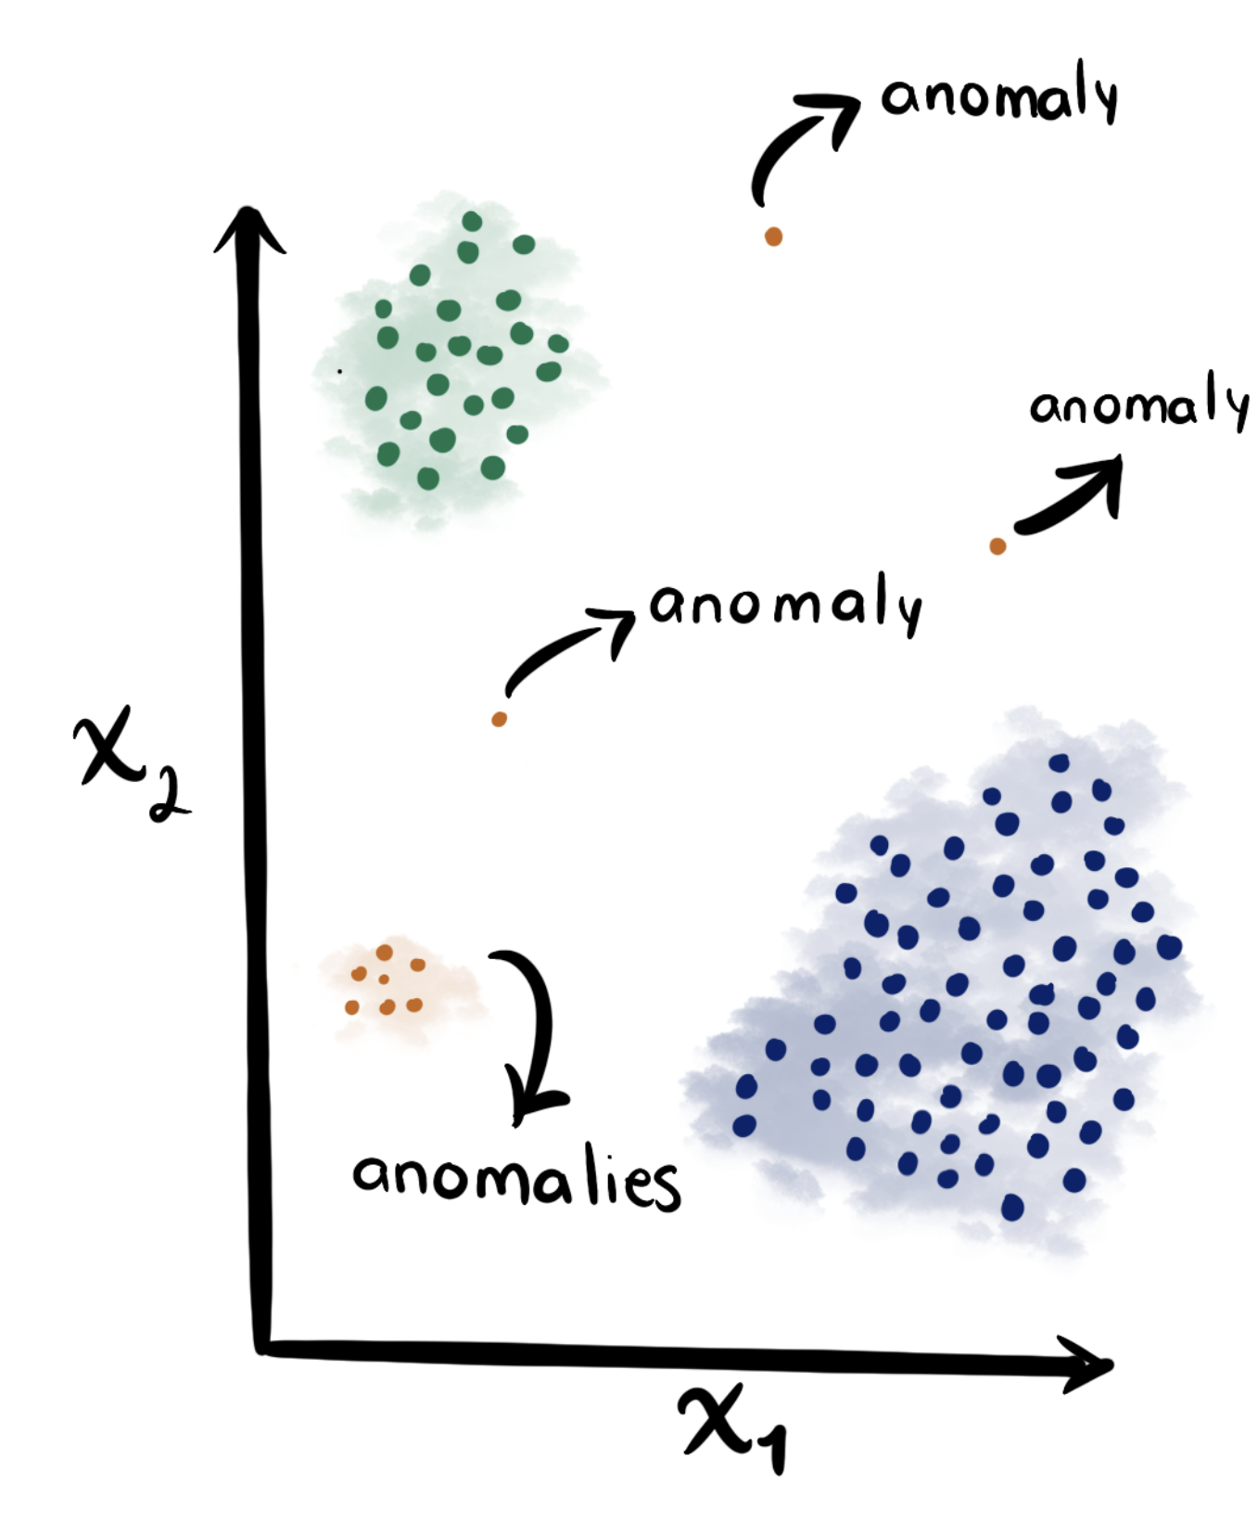
Anomaly Detection
Credit: Anomaly Detection
Notes:
Anomaly detection- check different clusters. See distance between point and its centroid. Check if its above a certain range.

Slide 10
Unsupervised Learning
Clustering
Dimension reduction
Notes:
So as you can imagine, unsupervised learning is a very broad term. Let’s narrow the discussion a bit by focusing on only two types of unsupervised learning: clustering and dimension reduction.

Slide 11
K-means clustering
Comfort
how do we find the clusters?
really terrible
Fashion
clusters can tell us specifics about the relationship of data
unsupervised learning!
…even if they are unlabeled!
Notes:
Clusters are thus pretty interesting! They rely on the natural similarities between subsections of your data. Imagine that you’re plotting Fashion versus comfort for shoes? You’re analyzing people’s responses on sneakers, crocs, slippers, and so on. What happens is that you analyze specific shoes and you see that some of them are more similar to each other than they are to other shoes So (click) this could indicate that the green dots are all sneakers. And (click)….
So clusters can tell us specifics about the relationship of data (click) even if your data is unlabeled! This begs the question… (click) how do we find the clusters?

Slide 12
Comfort
1. pick a K-number of clusters
2. randomly pick a series of “centroids”
3. assign each particle to the centroid closest to it
k=6
Fashion

Slide 13
Comfort
1. pick a K-number of clusters
2. randomly pick a series of “centroids”
3. assign each particle to the centroid closest to it
4.move the centroid to the weighted geometric center of samples assigned to it
k=6
Fashion
Notes:
Here, you can see that the datapoints have been colored in based on what centroid they’re closest to. They’ve been “assigned” to the closest centroid. Now, the next step is (click) to move the centroid to the weighted geometric center of the samples assigned to it. (next slide)

Slide 14
Comfort
1. pick a K-number of clusters
2. randomly pick a series of “centroids”
3. assign each particle to the centroid closest to it
4.move the centroid to the weighted geometric center of samples assigned to it
5. Repeat 3-4 until centroids stop moving!
k=6
Fashion
Notes:
Take a look! The centroids have just moved closer to their group. However, now that the centroids themselves have moved, the datapoints may be closer to a different centroid now. Take a look at the graph on the screen. You see those two blue dots in the pink cluster? Are they really closer to the blue centroid or to the pink one? This brings us to our next step which is to (click) repeat steps 3-4 until the centroids stop moving!
Let’s reassign the datapoints (next slide)

Slide 15
Comfort
1. pick a K-number of clusters
2. randomly pick a series of “centroids”
3. assign each particle to the centroid closest to it
4.move the centroid to the weighted geometric center of samples assigned to it
5. Repeat 3-4 until centroids stop moving!
k=6
Fashion
Notes:
Yeah! That looks a lot better doesn’t it? However, since we’ve just changed the datapoints near the centroid, the weighted geometric center of the samples associated with that centroid may have changed. Let’s repeat step 4. (next slide)

Slide 16
Comfort
1. pick a K-number of clusters
2. randomly pick a series of “centroids”
3. assign each particle to the centroid closest to it
4.move the centroid to the weighted geometric center of samples assigned to it
5. Repeat 3-4 until centroids stop moving!
k=6
Did we get back the same clusters?
Fashion
Nope. And that’s OK.
Notes:
Alright! Now our centroids have stopped moving. This basically occurs when the reassignment of the datapoints doesn’t change what centroid they are attached to.
One thing to keep in mind is that with k means clustering, every time you run it you may actually end up with different clusters. (click) (click) This is okay! There’s a certain degree of randomness built into the algorithm. This randomness comes from the initial step of choosing what datapoints to get the initial centroids from.

Slide 17
Did we get back the same clusters?
Nope. And that’s OK.
K-means is an indeterministic algorithm—it has built-in randomness

Slide 18
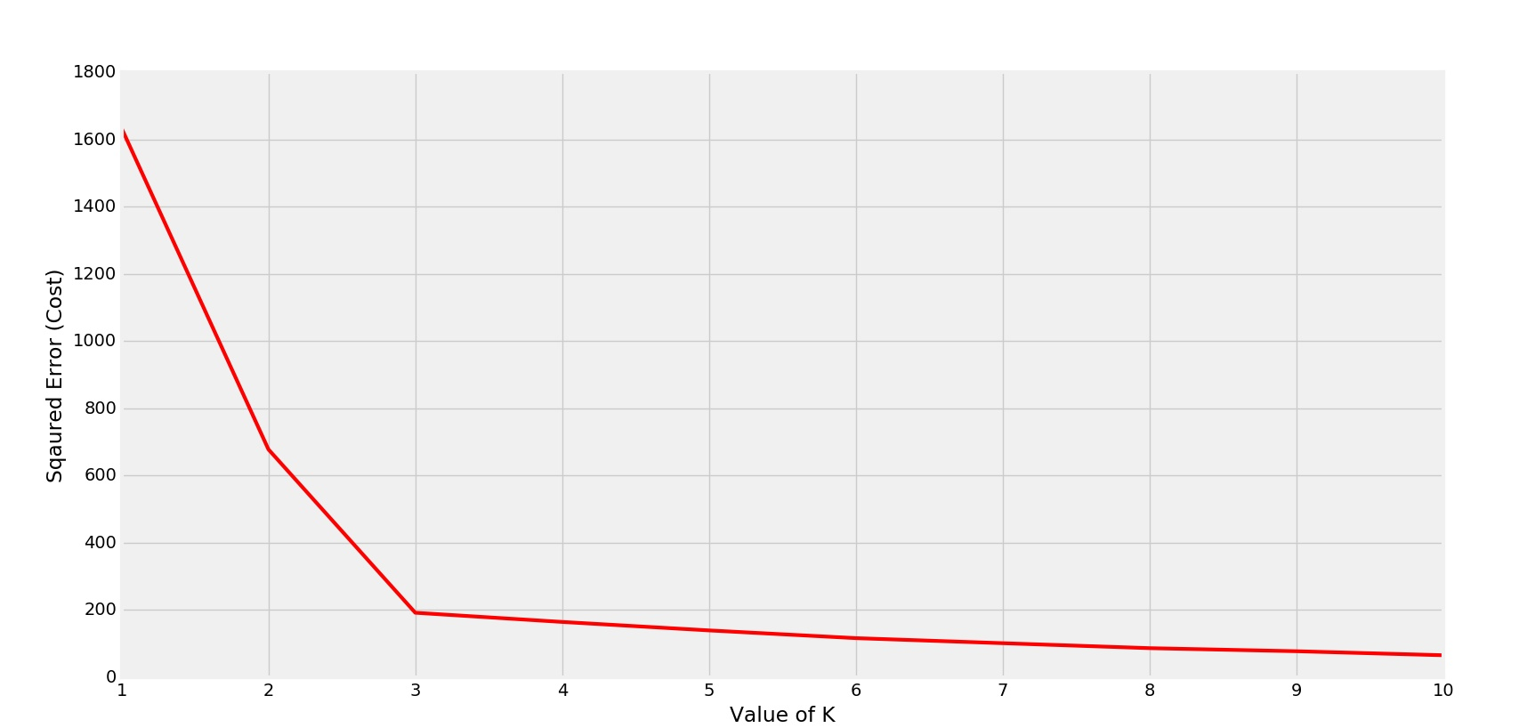
Evaluation and Choosing K
Notes:
How do we evaluate a clustering outcome? Talk about closeness.

Slide 19
Unsupervised Learning
Clustering
Dimension reduction
Notes:
Let’s take a 2 minute break to let the information just sink in. During the break, feel free to ask me questions!
Welcome back everyone! We’ve talked about clustering which as a quick recap is grouping data points together based on their similarities. We explicitly discussed k means clustering which involved calculating the centroids of your groups of data, grouping points based on their closeness to those centroids, and repeating these steps until the centroids stopped changing. Now, we’ll be moving into another subset of unsupervised learning called dimension reduction. We’ll be exploring what a dimension is, why we might be interested in the reducing the number of dimensions of our dataset, and how to do it safely through a method called principal component analysis.

Slide 20
Unsupervised Learning
Why Dimension reduction?
Notes:
Let’s take a 2 minute break to let the information just sink in. During the break, feel free to ask me questions!
Welcome back everyone! We’ve talked about clustering which as a quick recap is grouping data points together based on their similarities. We explicitly discussed k means clustering which involved calculating the centroids of your groups of data, grouping points based on their closeness to those centroids, and repeating these steps until the centroids stopped changing. Now, we’ll be moving into another subset of unsupervised learning called dimension reduction. We’ll be exploring what a dimension is, why we might be interested in the reducing the number of dimensions of our dataset, and how to do it safely through a method called principal component analysis.

Slide 21
Motivation for Dimension Reduction
Complex systems often must be modeled with large datasets, having dozens to millions of columns.
Often, several columns can be adding similar information to the model. So, there is a certain level of redundancy.
Additionally, datasets with too many features may be difficult to represent graphically.
Four dimensions; can’t even be graphed!
Individual | Height (cm) | Weight (kg) | Income ($) | Number of Children
Person A | 165 | 65 | 60,000 | 2
Person B | 168 | 63 | 100,000 | 5
Person C | 159 | 82 | 50,000 | 1
Person D | 183 | 68 | 90,000 | 4
Person E | 187 | 87 | 110,000 | 5
Person F | 189 | 89 | 95,000 | 4
Notes:
Oftentimes when you’re working with real datasets, you’ll be working with data that can have many tens or dozens of features; if not more. A cell can be structured according to the contribution of several dozens of genes. Or, in the case of the example I have here, you could be working in an insurance agency trying to analyze the risk offered by different individuals and there could be several factors that contribute to it. We can think of each of these different features as “dimensions”, because each feature adds a new direction of considering the data.
But as your dimensionality/ or number of dimensions rises, your dataset becomes more and more complicated. Modeling it goes from simple to cumbersome to impossible holistically. Take a look at our example here: with 4 dimensions we can’t model the data cleanly. Maybe we could have graphs of Height vs weight or income vs number of children, but we can’t realistically plot the 4 dimensions all together.
Yeah! That would be a fair guess. So to summarize, some of your features aren’t giving you the same amount of information as your other features. And there’s a need for being able to eliminate or remove some of them because that might make it easier to represent it either graphically or otherwise. But of course, this is something that needs to be done carefully else you can lose information and your dimensionally reduced data becomes less accurate. Which leads us to our next big question…

Slide 22
Motivation for Dimension Reduction
Individual | Height (cm) | Weight (kg) | Income ($) | Number of Children
Person A | 165 | 65 | 60,000 | 2
Person B | 168 | 63 | 100,000 | 5
Person C | 159 | 82 | 50,000 | 1
What if I have a lot of features, but not a lot of samples?
Notes:
What if I have a lot of features, but not a lot of samples? For example, here we have four features, but only three samples. If I want to use ML, what happens? For example, think about linear regression. IN general, when we do not have a lot of samples, a large # of features make learning algorithms easy to overfit.

Slide 23
Motivation for Dimension Reduction
Individual | Height (cm) | Weight (kg) | Income ($) | Number of Children
Person A | 165 | 65 | 60,000 | 2
Person B | 168 | 63 | 100,000 | 5
Person C | 159 | 82 | 50,000 | 1
Person D | 183 | 68 | 90,000 | 4
Person E | 187 | 87 | 110,000 | 5
Person F | 189 | 89 | 95,000 | 4
So, how do we reduce dimensionality without significant loss of information?
Notes:
“How do we reduce dimensionality without a significant loss of information”. Note that keyword: a “significant” loss. Because you’re removing a dimension we accept that your data will lose a slight bit of accuracy representing it. Think about how you’d describe your position in this classroom relative to the other people here. You can describe yourself in 3 dimensions with respect to your heights or in 2 dimensions with respect to the position of the chairs in this room. Since we’re mostly at the same heights you don’t lose much when trying to represent us in 2 dimensions. However, if we were all hiking up a mountain, and you tried to represent people’s positions in 2 dimensions, you would develop much greater inaccuracies.
So what we need is a way to reduce the number of dimensions without a significant loss of information. How could we do that?

Slide 24
Enter…
Principal Component Analysis
Notes:
Enter…principal component analysis.

Slide 25
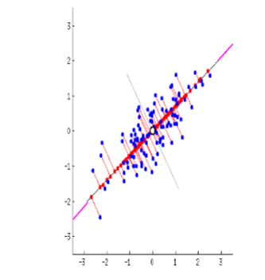
Principle Component Analysis
transform high-dimensional data into a new coordinate system, where the new features (principal components) are orthogonal (uncorrelated) and sorted in decreasing order of variance and use less # of dimensions to approximate the data.
Notes:
It is a popular dimensionality reduction technique used in machine learning and statistics. The main goal of PCA is to transform high-dimensional data into a new coordinate system, where the new features (principal components) are orthogonal (uncorrelated) and sorted in decreasing order of variance. This allows us to retain most of the important information of the data while reducing its dimensionality.
I also want to emphasize the orthogonal part. Some statistical tools require data to be independent, note that our features are not guaranteed to be independent by any means. This is another reason PCA can be useful.
PCA is Widely used for data preprocessing, visualization, and noise reduction. It helps in understanding the underlying structure of data, identifying dominant patterns, and improving the performance of machine learning models by reducing the curse of dimensionality. This is how PCA reduces dimensions.

Slide 26
Exploring Dimensions and Basis Vectors
z
y
(2,3,1) is a datapoint.
$\left[\begin{matrix}2 \\ 3 \\ 1\end{matrix}\right]$ is the vector to said datapoint.
(2,3,1)
x
Dimension = # of features
Notes:
Before we jump into PCA, I’d like to do a quick overview of some terminologies we use in the linear algebra involved. There are two terms we’ll be using quite prominently going forward: dimensions and bases. Let’s explore them.
For our purpose here, dimension is the # of features. For example, wine dataset, 12 features. Iris dataset: 4 features.
Here, we have a datapoint (2,3,1) And here is the vector to (2,3,1). One thing we see here is that this datapoint is expressed in terms of the three axes here x (click), y(click), and z(click).
So we refer to x,y, and z as basis vectors. Because here, in 3-dimensional space, every point can be expressed as a combination of the x,y, and z axes. They form the “basis” of 3 dimensional space.

Slide 27
Exploring Dimensions and Basis Vectors
y
y=x
y=-x
This gray point can be expressed as 3 blocks on x axis and 2 blocks on the y axis.
x
It can also be expressed as 1 block on y = -x and 3 blocks on y=x
Notes:
Here is a 2 dimensional space. Can anyone tell me what the basis vectors are here? Yes absolutely, x and y form the bases because every point in 2-D space can be expressed uniquely as some combination of x and y.
But your co-ordinate axes aren’t the only basis vectors you can have for this space. Here, Im going to draw 2 lines, y = x and y = -x. Any point that can be expressed with respect to the x axis and the y axis can also be expressed with respect to y=x and y=-x as well! In fact, there are infinite # of such basises. Each datapoint in the space can be uniquely represented in a set of bassies.
Dimensions are thus an analogue for the number of basis vectors you use to describe a space. This is a 2 dimensional space because you need only two basis vectors to express every point in 2-D space uniquely.
Now that we understand the idea of basis vectors, and we’re comfortable with using the word dimension as an alias for them, let’s get back to the question of why we would want to reduce them.

Slide 28
Projection
(0,0)
The projection (A’) of a point A on a particular line p is the point such that the line AA’ is perpendicular to p.
A
The projection of the point A on the purple line.
A’
p
Notes:
What we did earlier is a projection; in other words, how datapoints are represented in different basis.
What is the projection of a point on a line?
The projection of a datapoint on a line, is roughly speaking the “image” of that point along that line. Basically, the point on the line which is the shortest distance from the original datapoint is its projection. Here, A is our original datapoint, and A’ is its projection!
Mathematically, you can draw a projection by drawing a perpendicular from the data point to the line and where this perpendicular and the original line intersect you have your projection.
Take a look at the picture on the slide. A’ is the projection of A, and we can measure the distance from this projection to the origin.
Any questions so far?
Awesome! So now, that we understand what the projection of a point is, let’s see how it ties into the idea of a “principal component”. (next slide)

Slide 29
Principal Component Analysis
z
PC2
We can represent all data points along x,y,z axes in terms of new basis vectors PC1, PC2, and PC3.
PC1
x
PC3
y
Notes:
So what is principal component analysis? The idea behind principal component analysis is that you express your data in terms of new features as compared to the old ones. So here, I’m expressing my datapoints that were originally graphed with respect to x,y, and z. in terms of new basis vectors PC1, PC2, and PC3. PC1, PC2, and PC3 are some combinations of x,y, and z. Once you express the data in terms of these new axes, you can make a choice to drop an axis if you want. (click) Generally, you would use less features that you had originally, and these new features will be some linear combination of the old ones. However, there is an important caveat here that I will revisit later.
Take a look at the two graphs present here. On the left we have our original data. It’s expressed across 3 dimensions x,y, and z. After running principal component analysis, we can express our data similarly to the rightside plot: in terms of two new dimensions, PC1 and PC2. I want to stress once more than PC1 and PC2 are NOT x, or y or z but rather new features which are a result of some combination of the old ones.
PC1 and PC2 stand for principal component 1 and principal component 2. The new axes/features that PCA gives you are called principal components. Not only are they another possible way of expressing your data, they’re the best possible way of expressing the differences between your data points. Now, what does that mean? What does it mean to be the best possible way of expressing the differences between data points? Let’s explore that.

Slide 30
Principal Component Analysis
z
PC2
3-dimensional graph reduced to 2-dimensional graph across different basis vectors (“principal components”)
PC1
x
y
Notes:
Generally, you would use less features that you had originally, and these new features will be some linear combination of the old ones.
Take a look at the two graphs present here. On the left we have our original data. It’s expressed across 3 dimensions x,y, and z. After running principal component analysis, we can express our data similarly to the rightside plot: in terms of two new dimensions, PC1 and PC2. I want to stress once more than PC1 and PC2 are NOT x, or y or z but rather new features which are a result of some combination of the old ones.
PC1 and PC2 stand for principal component 1 and principal component 2. The new axes/features that PCA gives you are called principal components. Not only are they another possible way of expressing your data, they’re the best possible way of expressing the differences between your data points. Now, what does that mean? What does it mean to be the best possible way of expressing the differences between data points? Let’s explore that.

Slide 31
Principal Component Analysis
How do we decide which PCs to drop when reducing the dimensionality of the data?
Notes:
Let’s back to the overarching question. Once we generate our new features, how do we pick one of them to drop so that we can reduce the dimensionality? (next slide)

Slide 32
Principal Components
Think of these as new axes that we are orienting our data across.
So instead of x,y, z, rather some linear combination of them.
They are done such that each principal component is uncorrelated with the others, so that translation across each component indicates different information. So, they represent directions of maximal variance.
This allows differences between data points to become more prominent
How do we decide which PCs to remove when reducing the dimensionality of the data?
Represents percentage of variance for each PC. Notice how PC1 has the most and it drops after that.
Since PC3 accounts for a very small percentage of overall variance, we can remove it. This is how PCA reduces dimensionality
Notes:
I called our new features principal components. I also talked about how, if you want to reduce the dimensionality, you can choose to drop one of your principal components. Let’s explore what they are and how to do so.
Your principal components are new basis vectors. They can be thought of as new axes that we are orienting our data across. Each principal component is effectively a combination of your old features. Each principal component is orthogonal or uncorrelated with the other ones, to avoid any redundancy in terms of the information being expressed. Also, they are directions of maximal variance, a term which I will explain soon.
Here, I have a graph (called a scree plot) that represents the variance along each of our principal components. If we want to reduce the dimensionality at the end, we can choose to remove PC3 since the variance of PC3 is not very significant compared to PC1 and PC2. This is how PCA accomplishes dimension reduction.
Do we have any questions on how we can accomplish dimension reduction with PCA?
Awesome! So let’s explore what I mean by directions of maximal variance, and why we want our principal components to maximize the variance along them.

Slide 33
Principal Component Analysis
How do we decide the PCs?
Notes:
Let’s back to the overarching question. How do we decide the PCs?

Slide 34
Principal Component Analysis
Notes:
Consider a simple case, we have a 2D space with multiple points. We want to find PC1 (and only use PC1). Which line is better? Remember we need to do projection.

Slide 35
Principal Component Analysis
Notice how the points spread out from each other and from the origin.
Notes:
The points project to this basis. This is what it looks like. Look at the spread of the points.
Or does this one do it better? Let’s open it up to the audience. What do you think?
What exactly is the difference between these two possible axes? I mean in the sense of how they relate to the points already present there.
Yes, the points are more spread out here! What does it mean for these points to be spread out? It means that they vary more along that line. Can you think of why it is important for these points to vary more along the line?
Yeah, so because they vary more, or are more spread out, it becomes easier to tell the different datapoints apart. We can quantify this spread by measuring the sum of the distances of these points from the origin. One thing however, that you will notice about the datapoints on both this slide and the previous slide are that all the datapoints sort of fall along the new axis we come up with. Realistically, your data will look something like this (next slide)

Slide 36
Principal Component Analysis
Notes:
This is the projection to another basis. Take a look at this graph. Is it easier to tell the differences between the points here? Or (click)

Slide 37
Principal Component Analysis
We can quantify the “spread” of the points by measuring the sum of the distances of these points from the origin
1st base or “Principal Component 1”. Line that maximizes sum of distances of projections of points from origin. In essence, maximizes variance of distribution.
Notes:
We think this one works better. It better preserves the spread among the datapoints. We call this first PC. I just want to mention that mathematically, we quantify the spread by measuring the sum of the distances of these points from the origin. We want to maximize it.
But we can also describe this ideal base as the base or axis that maximizes the distances of the projections of these points on the axis from the origin. One reason why we want to reframe it this way is because by maximizing the sum of the distances of the projections of these points, you end up getting an axis that maximizes the variance as you go along it. This is important because when the variance is maximized, the differences between points become more pronounced.
Now, that’s a mouthful, and it is difficult initially to see how those two descriptions are interrelated. Bear with me! I promise it’ll make sense at the end. For now, just keep that description in your mind –it’s on the slide there- that the ideal base or axis is the one that maximizes the sum of the distances of projections of the points on that axis from the origin.
Let’s start breaking it down with a closer look at that word “projection.”

Slide 38
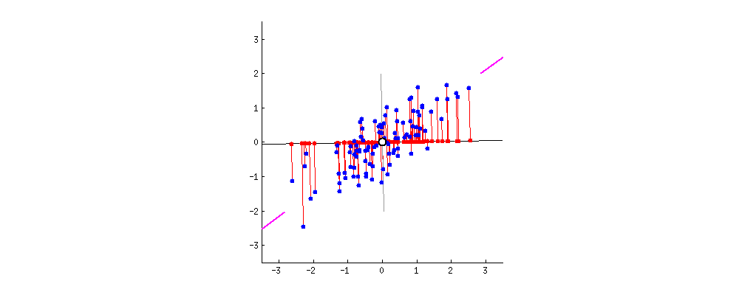
Principal Component Analysis
Maximizing the variance along the line
Built using https://gist.github.com/anonymous/7d888663c6ec679ea65428715b99bfdd
Notes:
EMPHASIZE this graph.
Take a look at this graph right here. Notice the revolving axis. The red dots on the revolving line represent the projections of the blue datapoints on the revolving axis. As the line rotates, take a look at the “spread” of the red dots along the axis. The “spread” of these points represents the variance along that revolving line.
We want to pick an axis that maximizes the variance. So something like this (click)

Slide 39
Principal Component Analysis
Maximizing the variance along the line
Notes:
This line here, has the biggest spread of red dots. This means, this line is along the maximally variant direction.
So to be a maximally variant direction, an axis has to have the largest spread of the projections of the datapoints on it.

Slide 40
Principal Component Analysis
Keep going
Notes:
After selecting the first direction, keep going to find the next direction to maximize the variance of the remain of the data until all variances are explained. Or in most cases, reach n dimensions. IN this case, it is 2-D. If you have 4 features, as in the Iris dataset, we …

Slide 41
Principal Component Analysis
Standardization
Covariance Matrix Calculation
Eigenvector Calculation
Form Principal Components and Build Graph
Notes:
So, let’s recap. Principal component analysis is basically expressing your old data with respect to new features! These new features or axes are picked based on how well they maximize the variance along them.
Now that we’ve covered the general idea behind principal component analysis and why we want to do it, let’s get into how to do it. There’s four broad steps to PCA: Standardizing the data, calculating the covariance matrix, calculating the eigenvectors, selecting principal components and building the graph (if need be) for it.

Slide 42
Standardization
Individual | Height (cm) | Weight (kg) | Income ($) | Number of Children
Person A | 165 | 65 | 60,000 | 2
Person B | 168 | 63 | 100,000 | 5
Person C | 159 | 82 | 50,000 | 1
Person D | 183 | 68 | 90,000 | 4
Person E | 187 | 87 | 110,000 | 5
Person F | 189 | 89 | 95,000 | 4
Compare the data of each of the 4 columns. How do they differ numerically?
Notes:
Let’s get into standardization. Take a look at this data I have mocked up here. Each “Sample” is represented by the individual, and our features are Height, Weight, Income, and Number of Children. Now, take a look at the values inside each column. Notice how the values in the height column roughly vacillate between 159 and 189. Number of children on the other hand just goes from 1 through to 5. Income however varies the most: it ranges from 50,000 to 110,000. (click)

Slide 43
Standardization
Individual | Height (cm) | Weight (kg) | Income ($) | Number of Children
Person A | 165 | 65 | 60,000 | 2
Person B | 168 | 63 | 100,000 | 5
Person C | 159 | 82 | 50,000 | 1
Person D | 183 | 68 | 90,000 | 4
Person E | 187 | 87 | 110,000 | 5
Person F | 189 | 89 | 95,000 | 4
Range | 159-189 | 63-89 | 50,000-110,000 | 1-5
Variance | 161.76 | 135.87 | 564166666 | 2.7
Compare the data of each of the 4 columns. How do they differ numerically?
Their range varies drastically. Consequently, their variances are very different.
Notes:
The ranges of each feature are dramatically different! Consequently, the variances differ dramatically too as you can see here. This is going to be a problem.
In PCA, your new features are expressed in terms of combinations of the old ones. If we use this data the way it is, then features like Income are going to have an outsized contribution to the formation of the new features. This means the resulting principal components are going to be biased in the direction of Income.
(click)

Slide 44
Standardization
Individual | Height (cm) | Weight (kg) | Income ($) | Number of Children
Person A | 165 | 65 | 60,000 | 2
Person B | 168 | 63 | 100,000 | 5
Person C | 159 | 82 | 50,000 | 1
Person D | 183 | 68 | 90,000 | 4
Person E | 187 | 87 | 110,000 | 5
Person F | 189 | 89 | 95,000 | 4
Range | 159-189 | 63-89 | 50k-100k | 1-5
Variance | 161.76 | 135.87 | 564166670 | 2.7
If this is not addressed, some of the feature columns will dominate over the other ones.
This can bias the results and final principal component analysis; making it difficult to view differences between values in one column compared to another.
So final graph may have the differences between the weights of various persons be miniscule.
Notes:
Here I’m just summarizing the main points we’ve covered so far. We don’t want one feature to dominate over the other here. Do we feel convinced by why this is a problem (pause for questions)
Alright, if we are, this then brings up another question. (next slide)

Slide 45
Standardization
So, how do we adjust our data so these differences are not as drastic?
Notes:
How do we adjust our data so these differences are not as drastic? Anyone have any ideas? (ask audience)

Slide 46
Standardization
Recap: we want to put different variables on the same scale.
This can mean many things from giving them the same mean and standard deviation, to keeping the range consistent, and so on.
Here, we will use a method called z-scoring.
The rescaled distribution will have a mean of 0 and standard deviation of 1
Note: it does not mean the new data follow Normal distribution
Notes:
We are going to standardize our data! This way we make sure the standard deviation across all the different features is This way, we keep the variances of the different features the same. There are many ways of standardizing your data, but the one I generally use is z scoring. Here, you go through every value in the column, subtract the mean from it and divide it by the standard deviation of the column.

Slide 47
Principal Component Analysis
Standardization
Covariance Matrix Calculation
Eigenvector Calculation
Form Principal Components and Build Graph
Notes:
Now that we understand standardization, let’s talk a bit about the actual dimension reduction. I mentioned before how PCA lets you express your dataset from old features to new ones. However, there are times you want to reduce the number of dimensions. In these scenarios, you have to pick one of your new features to drop, and try to transform your datapoints to express them in terms of the remaining new features. So, how do we pick a new feature to drop? We do so with the help of something called a covariance matrix.

Slide 48
Covariance Matrix Calculation
Covariance is really just a measure of how correlated two variables/features are.
If your covariance is positive, that means there’s a positive correlation.
If your covariance is negative, that means there’s a negative correlation.
$$Cov\left(x,y\right)=\sum{\frac{(x_{i} − \overline{x})(y_{i} − \overline{y})}{N−1}}$$
Notes:
Before we start talking about the covariance matrix, let’s go over what covariance is. The covariance of two features x and y is a measure of how correlated x and y are. If it’s positive, there’s a positive correlation, which means when x goes up, y goes up too. If it’s negative, there’s a negative correlation, which means when x goes up, y actually goes down.
I want to reemphasize the PCA tries to utilize the correlation of variables to reduce dimension. Recall the revolving lines, you see the data has a positive colleration between x and y axes. And the PC1 captures that well.
Covariance matrix is the quantitative way to capture such correlations.
Anyone have any questions on covariance? It will be an important concept going forward.
Awesome! Let’s move on.

Slide 49
Covariance Matrix Calculation
What should our new features look like?
Review: Lecture 7; feature engineering
Make new features with high variance.
Pick new features with low correlation to other features.
Notes:
So the question we have what should our new features look like? Well, we want them to be along maximally variant directions like we talked about earlier. Additionally, we would like it if each of our new features had little correlation to each other. This is to avoid redundancy in information expressed by these axes.
Where do we start? We can start by first trying to capture the correlation between our existing features. (click)

Slide 50
Covariance Matrix Calculation
Can measure this correlation using covariance. If covariance is positive, then features are correlated in the sense they both increase together. If covariance is negative, then features are inversely correlated.
$$Cov\left(x,y\right)=\sum{\frac{(x_{i} − \overline{x})(y_{i} − \overline{y})}{N−1}}$$
Notes:
We can measure this correlation using covariance. Here, x y and z represent our initial features after being standardized.

Slide 51
Principal Component Analysis
Standardization
Covariance Matrix Calculation
Eigenvector Calculation
Form Principal Components and Build Graph

Slide 52
Eigenvector Calculation
We can think of matrices as transformations of vectors.
When you multiply a matrix with a vector; two things happen:
It scales the vector.
It rotates the vector
(1,2)
$$\left[\begin{aligned}1 2 \\ 2 1\end{aligned}\right]\left[\begin{matrix}1 \\ 2\end{matrix}\right]=\left[\begin{aligned}5 \\ 4\end{aligned}\right]$$
Notes:
Naturally, before we start calculating our eigenvectors it’s important to understand what they are. I will be discussing not only how they act mathematically, but will also try to build some intuition regarding them. Of course, if you have a background in linear algebra these next few slides may not be as useful for you.
Let’s rethink how we view matrices. Yes, they’re handy ways to conceptualize data but graphically speaking, one can think of a matrix as a transformation. It scales and rotates the vector you multiply with it. In this example, I have a matrix 1 2 2 1 which Im using to represent a basic transformation. Additionally, I have a vector to the datapoint (1,2). Now when I multiply them together (click),

Slide 53
Eigenvector Calculation
We can think of matrices as transformations of vectors.
When you multiply a matrix with a vector; two things happen:
It scales the vector.
It rotates the vector
(5,4)
$$\left[\begin{aligned}1 2 \\ 2 1\end{aligned}\right]\left[\begin{matrix}1 \\ 2\end{matrix}\right]=\left[\begin{aligned}5 \\ 4\end{aligned}\right]$$
Notes:
You can see how the vector itself has been scaled and rotated! Notice how the magnitude of the vector is larger now and by that I roughly mean the length of the line. Notice how it was rotated slightly too.
So, for most vectors, this matrix will rotate AND scale them. However, there are certain vectors which characterize the transformation for whom no rotation occurs. We call these eigenvectors

Slide 54
Eigenvector Calculation
Eigenvectors are characteristic vectors specific to a matrix or transformation.
Graphically speaking, when you multiply a matrix with its specific eigenvectors, the eigenvectors don’t get rotated, only scaled.
(1,1)
$\left[\begin{aligned}1 2 \\ 2 1\end{aligned}\right]\left[\begin{aligned}1 \\ 1\begin{matrix} \\ \end{matrix}\end{aligned}\right]=\left[\begin{aligned}3 \\ 3\end{aligned}\right]$ = $3\left[\begin{matrix}1 \\ 1\end{matrix}\right]$
Notes:
Here, [1,1] is an eigenvector of the matrix [1,2;2,1]. Notice how(click)

Slide 55
Eigenvector Calculation
Eigenvectors are characteristic vectors specific to a matrix or transformation.
Graphically speaking, when you multiply a matrix with its specific eigenvectors, the eigenvectors don’t get rotated, only scaled.
The factor by which an eigenvector is scaled is called its eigenvalue
(3,3)
$\left[\begin{aligned}1 2 \\ 2 1\end{aligned}\right]\left[\begin{aligned}1 \\ 1\begin{matrix} \\ \end{matrix}\end{aligned}\right]=\left[\begin{aligned}3 \\ 3\end{aligned}\right]$ = $3\left[\begin{matrix}1 \\ 1\end{matrix}\right]$
Notes:
The eigenvector only gets scaled, not rotated. It’s still along the same direction. The factor by which an eigenvector is scaled is called its eigenvalue. The arrow is just bigger! Let’s take this further. A matrix can actually have (click) multiple eigenvectors.

Slide 56
Eigenvector Calculation
(-1,1)
(1,1)
$\left[\begin{aligned}1 2 \\ 2 1\end{aligned}\right]\left[\begin{aligned}1 \\ 1\begin{matrix} \\ \end{matrix}\end{aligned}\right]=\left[\begin{aligned}3 \\ 3\end{aligned}\right]$ = $3\left[\begin{matrix}1 \\ 1\end{matrix}\right]$
$\left[\begin{aligned}1 2 \\ 2 1\end{aligned}\right]\left[\begin{aligned}−1 \\ 1\begin{matrix} \\ \end{matrix}\end{aligned}\right]=\left[\begin{aligned}1 \\ −1\end{aligned}\right]$ = $−1\left[\begin{matrix}−1 \\ 1\end{matrix}\right]$
Notes:
The eigenvector only gets scaled, not rotated. It’s still along the same direction. The arrow is just bigger! Let’s take this further. A matrix can actually have (click) multiple eigenvectors. As you can see here, the two vectors (1,1) and (-1,1) get scaled and not rotated when multiplied with the matrix. (click).
How are we feeling about the concept of eigenvectors? Any questions? (open to questions). Awesome!

Slide 57
Eigenvector Calculation
(3,3)
(1,-1)
$\left[\begin{aligned}1 2 \\ 2 1\end{aligned}\right]\left[\begin{aligned}1 \\ 1\begin{matrix} \\ \end{matrix}\end{aligned}\right]=\left[\begin{aligned}3 \\ 3\end{aligned}\right]$ = $3\left[\begin{matrix}1 \\ 1\end{matrix}\right]$
$\left[\begin{aligned}1 2 \\ 2 1\end{aligned}\right]\left[\begin{aligned}−1 \\ 1\begin{matrix} \\ \end{matrix}\end{aligned}\right]=\left[\begin{aligned}1 \\ −1\end{aligned}\right]$ = $−1\left[\begin{matrix}−1 \\ 1\end{matrix}\right]$
Notes:
The eigenvector only gets scaled, not rotated. It’s still along the same direction. The arrow is just bigger! Let’s take this further. A matrix can actually have (click) multiple eigenvectors. As you can see here, the two vectors (1,1) and (-1,1) get scaled and not rotated when multiplied with the matrix. (click).
How are we feeling about the concept of eigenvectors? Any questions? (open to questions). Awesome!
One thing you may notice is that these two eigenvectors are rather familiar. (1,1) takes the shape of y=x, and (-1,1) takes the shape of y = -x. From our earlier discussion earlier of basis vectors, what that reveals is… (click)

Slide 58
Eigenvector Calculation
The two eigenvectors are perpendicular to each other!
Eigenvectors act as basis vectors!
Every point in 2-D can be expressed as some combination of (1,1) and (-1,1).
Notes:
The eigenvectors act as basis vectors! Now, every point in 2-D can be expressed with respect to these two vectors.
More generally, if a matrix has the same number of eigenvectors as it has dimensions, then those eigenvectors act as basis vectors.
Now that we have a clearer idea of what eigenvectors are, and how they can act as basis vectors, we can start to see how they can be useful for principal component analysis!
(click)
Remember that the entire point of PCA is to find new dimensions to graph our points in. With eigenvectors, We know they act as basis vectors which means we know that any datapoint that could be expressed with respect to the old dimensions, could be expressed with respect to the eigenvectors of a carefully chosen matrix.

Slide 59
Eigenvector Calculation
Citric acid
Eigenvector 2
Fixed acidity
Eigenvector 1
Notes:
Remember that the entire point of PCA is to find new dimensions to graph our points in. With eigenvectors, We know they act as basis vectors which means we know that any datapoint that could be expressed with respect to the old dimensions, could be expressed with respect to the eigenvectors of a carefully chosen matrix.
Here, imagine that the two dots represent two samples of wine. We can try to represent these samples as two datapoints on a graph of fixed acidity vs citric acid content. However, if we pick a matrix carefully, and find the eigenvectors of this matrix, we can end up with a new basis that can still represent those wine samples. How do we feel about this concept? (pause for questions)
Perfect! Now you can see how this is useful for PCA. When we’re trying to describe our datapoints in terms of the new features we come up with in PCA, we want to make sure every datapoint can be accurately represented. Using eigenvectors, we can ensure that!
You may have noticed that I keep mentioning that we have to pick a carefully chosen matrix to find the eigenvectors of. This begs the question…(click)

Slide 60
Eigenvector Calculation
What matrix do we find the eigenvectors of to get our “new features” in PCA?
Notes:
What matrix do we find the eigenvectors of to get our “new features” in PCA? It’s actually a matrix that we talked about earlier this lecture. Anyone want to try and guess? (question to audience)
Yup that’s right. It’s the covariance matrix (click).

Slide 61
Eigenvector Calculation
By calculating the eigenvectors of the covariance matrix, we can get our principal components.
We use the eigenvectors to create a basis for the graph. These basis vectors represent the principal components.
Since these are eigenvectors of the covariance matrix, they represent directions of maximal variance.
A =
$$Av= λv$$
v is the eigenvector and lambda is the eigenvalue
Notes:
The eigenvectors of the covariance matrix are called principal components. They’re what make PCA!

Slide 62
Eigenvector Calculation
$$Av= λv$$
$$Av− λv=0$$
$$A=$$
$$(A− λ)v=0$$
$$|A− λ|=0$$
When you find the root of the resulting polynomial, you will find all the possible eigenvalues. For each eigenvalue, plug it into the original equation to find the corresponding eigenvector v.
Notes:
This is a slide you can tune out of if you’re not interested. It’s a broad description of how to calculate eigenvectors mathematically.

Slide 63
Principal Component Analysis
Standardization
Covariance Matrix Calculation
Eigenvector Calculation
Form Principal Components and Build Graph

Slide 64
Form Principal Components and Build Graph
${\text{Let} \text{the} \text{three} \text{eigenvalues} \text{of} \text{the} \text{three} \text{eigenvectors} v_{1}{, v}_{2,},v_{3} \text{be} λ}_{1}, λ_{2}, λ_{3}$ $\text{such} \text{that} λ_{1}>=λ_{2}>=λ_{3}$
$$\text{Then}\text{, }\text{the} \text{principal} \text{components} \text{will} \text{be} v_{1}{, v}_{2,},v_{3} \text{and} \text{the} \text{variances} \text{they} \text{carry} \text{are} \text{in} \text{the} \text{ratio} \text{of} λ_{1}, λ_{2}, λ_{3}$$

Slide 65
Form Principal Components and Build Graph
But if the eigenvectors are from the covariance matrix which represents the correlation of all the features, where will we be removing features?
$$\text{If} \text{the} \text{percentage} \text{of} \text{variance} \text{of} \text{a} \text{particular} \text{principal} \text{component} \text{is} \text{small} \text{enough}\text{, }\text{discard} \text{it}\text{. }\text{You}\text{′}\text{ve} \text{now} \text{removed} \text{a} \text{dimension}\text{! }\text{Form} \text{a} \text{new} \text{matrix} \text{which} \text{only} \text{has} \text{the} \text{eigenvectors}\text{/}\text{principal} \text{components} \text{you}\text{′}\text{ve} \text{selected}\text{.}$$
$$\text{Let} \text{this} \text{matrix} \text{be} \text{called} \text{your} \text{Feature} \text{Vector}\text{.}$$

Slide 66
Now, it’s time to reorient the original data along these new axes

Slide 67
Form Principal Components and Build Graph
PC3
PC1
PC2

Slide 68
Form Principal Components and Build Graph
PC2
The third dimension was removed as it did not contribute much in terms of variance
PC1
PC3

Slide 69
Principal Component Analysis
Linear transformation of existing features
Each PC is selected to maximize the explained variance in this direction of the remain data
Dimensionality reduction is to remove dimensions with low variances
Tradeoff between dimensionality vs. info. loss

Slide 70
A real-world application of PCA
PC1 or g factor
SAT Math
$IQ testing!$
SAT Verbal
Notes:
Looking at people’s intelligence, saw that it correlated across multiple subjects. So tried to set out to find one way to quantify intelligence called the “g factor” initially.
Ask them about their uses of PCA in their field!

Slide 71
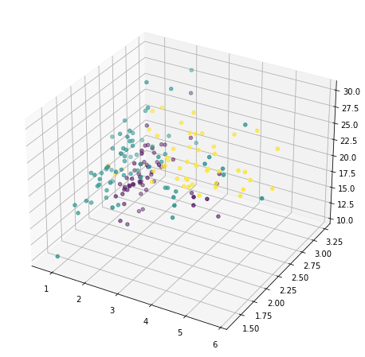
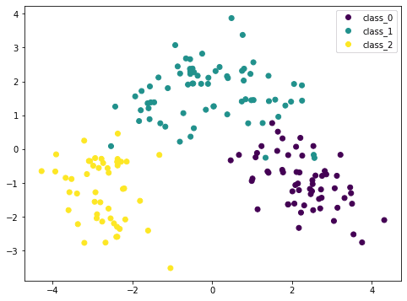
Data Visualization
The wine dataset with 13 features and 3 classes.
Source: https://machinelearningmastery.com/principal-component-analysis-for-visualization/
Notes:
IN this case, the toy wine dataset has 13 features and 3 classes. Note this is different from the wine dateset we are using. If we pick any of the three dimensions and use color to identify the wine type, we got a somewhat mixed clusters. However, if we do PCA, and then pick the first two PCs and plot, we see clear clusters.

Slide 72
Feature Extraction
Q: feature extraction vs. feature selection?
The wine dataset with 13 features and 3 classes.
Source: https://machinelearningmastery.com/principal-component-analysis-for-visualization/
Notes:
This is particularly important when the number of samples is small, especially compared to the number of features.
Discussion the difference between the two
Emphasize featcture extraction is a linear combination of all features, and thus lose interpretability.

Slide 73
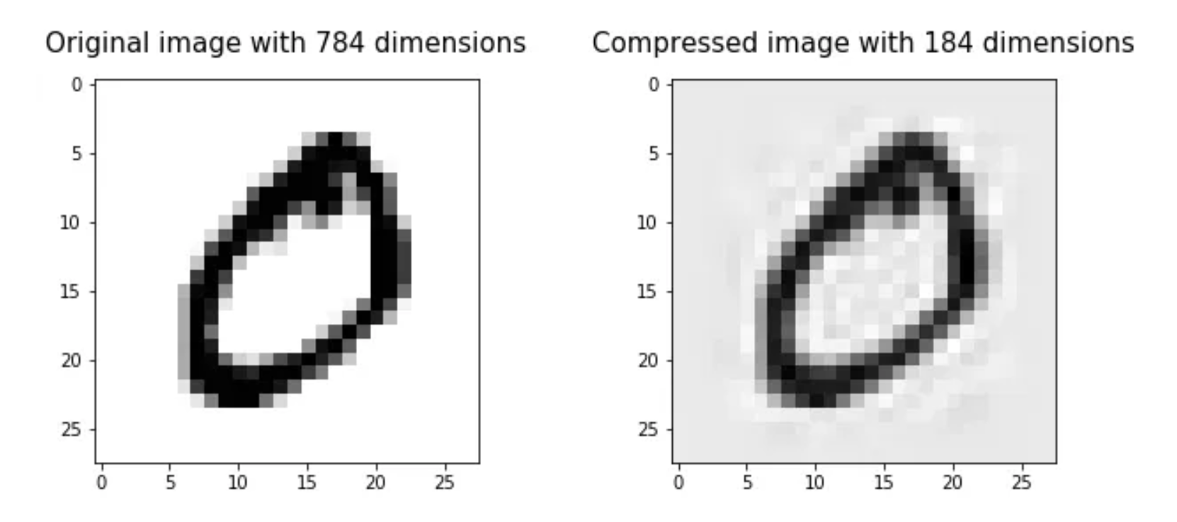
Image Compression
Source: https://towardsdatascience.com/image-compression-using-principal-component-analysis-pca-253f26740a9f

Slide 74
Noise Reduction
Source: https://stats.stackexchange.com/questions/247260/principal-component-analysis-eliminate-noise-in-the-data

Slide 75
t-SNE

Slide 76
t-SNE
Non-linear dimensionality reduction technique, probabilistic
Mostly used for data visualization for high dimensional data
Key advantage: preserves local structure (i.e., points close in high dimensional space are still close in low dimensional space)
Computationally expensive, sensitive to hyperparameters
Notes:
In general, not used to extract features because

Slide 77
Unsupervised Learning
Clustering
Dimension reduction (PCA and t-SNE)
Comfort
k=6
Fashion
Notes:
So as you can imagine, unsupervised learning is a very broad term. Let’s narrow the discussion a bit by focusing on only two types of unsupervised learning: clustering and dimension reduction.

Slide 78
Quiz time
What is the primary goal of clustering?
a) To reduce the dimensionality of data
b) To classify data points into predefined categories
c) To group similar data points together
d) To predict future data points

Slide 79
Which of the following is NOT a common clustering algorithm?
a) K-Means
b) Hierarchical Clustering
c) Linear regression
d) K-nearest-neighbor

Slide 80
True or False: K-Means clustering always finds the global optimum solution.

Slide 81
Compare
Feature engineering
Feature selection
PCA
t-SNE

Slide 82
What is often used for feature extraction?
a) T-SNE
b) PCA
c) KNN

Slide 83
What statement is true about PCA?
a) The data is normally distributed
b) The principal components are orthogonal to each other
c) The data has equal variance in all directions
d) The data is categorical

Slide 84
Which of the following is true about the first principal component?
a) It has the smallest variance among all possible components
b) It has the largest variance among all possible components
c) It is orthogonal to the original variables
d) It is the mean of all variables

Slide 85
t-SNE is an effective tool for visualizing clusters in high-dimensional data. (True or False)

Slide 86
What is the role of the covariance matrix in PCA?
a) To scale the data
b) To perform clustering
c) To capture the variance and correlation structure of the data
d) To normalize the data

Slide 87
Which of the following is an example of feature engineering?
a) Scaling numerical features to a standard range
b) Applying PCA to reduce dimensionality
c) Creating new features from existing ones, such as the interaction term between two variables
d) Splitting the dataset into training and testing sets
Notes:
b) And c)

Slide 88
True or false: The largest PCA component should be the best feature for classification.
Notes:
False: PCA captures the variance in data. They may not be good features for a particular task. For example, temperature may vary a lot, but not necessirly a good feature to predict say image of a dog.

Slide 89
Potential Pitfalls

Slide 90
Things that can go wrong
Potential Pitfalls
Inconsistent preprocessing
Data leakage
Model is used on test data that has changed
Selecting appropriate metrics
Hidden confounders
Spurious correlations
Performance on subgroups may be missing
Data biases
Notes:
https://towardsdatascience.com/machine-learning-pitfalls-e54ac3edc25

Slide 91
Data Leakage
Example 1: Use wearable sensors to classify subject activity
Example 2: Use ECG data to classify subject state
Example 3: Use ECG data collected during word repetition tests to classify subject cognitive status
Example 4: Use production data to predict disease outbreak in swine farms
Notes:
https://towardsdatascience.com/data-leakage-in-machine-learning-how-it-can-be-detected-and-minimize-the-risk-8ef4e3a97562
Per subject (split data based on subjects), over time (do not use data from later time), feature engineering (do not use test data)

Slide 92
Things that can go wrong
Potential Pitfalls
Inconsistent preprocessing (e.g., different scaling/normalization)
Data leakage (e.g., temporal or mixing subjects)
Model is used on test data that has changed
Selecting appropriate metrics (e.g., is 99% accuracy good enough?)
Hidden confounders (e.g., golf is correlated with heart attacks)
Spurious correlations (e.g., hospital ID on images)
Performance on subgroups may be missing
Data biases (e.g., AI recruiter)
Notes:
https://towardsdatascience.com/machine-learning-pitfalls-e54ac3edc25

Slide 93
Project

Slide 94
Typical steps to apply ML
Data preprocessing
Trying different ML algorithms
Training set, validation set, test set
Diagnostics
More training samples
Increase/decrease feature set
Increase/decrease regularization
Loop back

Slide 95
A ML Project
Why ML is a suitable approach
Do not use ML for the purpose of using ML
Evaluate existing approaches and room for improvement
Problem abstraction and formulation
Set appropriate goals
Model complexity, data availability, evaluation
Domain knowledge critical
Data collection and data cleaning
What, where, and how
ML algorithms
This is often the “easy” part
Evaluation, sanity check, interpretation
Iterate the process
Notes:
Problem abstraction and formulation can be important. In networks, the number of states can be extremely large is not carefully managed. This is a place where domain knowledge can be important. What are the important features, what are independent, what is the time granularity?
Consider the cellular QoE example (call complain). There are many different ways we could potentially formulate the problem: prediction-model + optimization, bandit algorithms, RL, deep RL. Data availability is a key factor. Learning complexity is another.
Set appropriate goals: ex: "Many studies applying machine learning to viticulture aim to optimize grape yields, but winemakers “want the right levels of sugar and acid, not just lots of big watery berries”.”

